Slide 1
Intro To Programming JavaScript

Slide 2
Brief Summary Of Chapter 2
What is data
Types of Data
Variables
Using slice method
Chapter 2: Data Types And Variables

Slide 3
Data is information we collect and save for later, to use in various ways. It comes in different forms like words, numbers, pictures, sounds, and videos, and we can store it on computers to work with or look at whenever we need to.
What is Data?

Slide 4
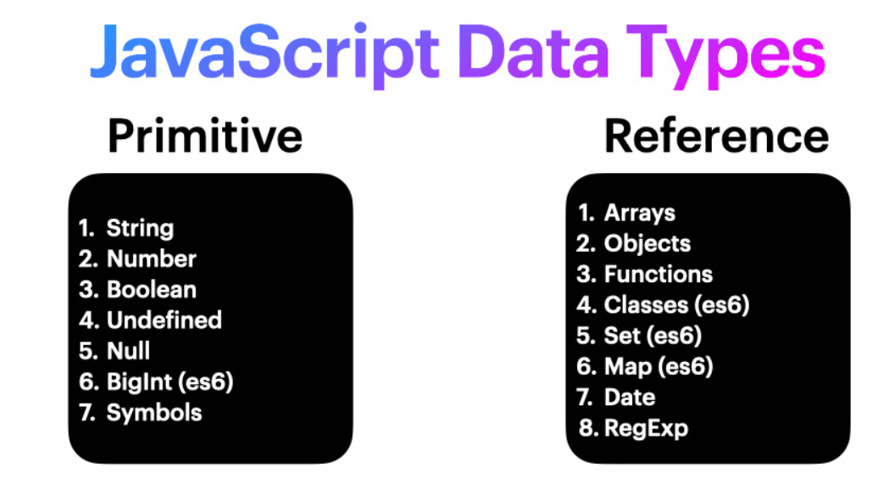
Types Of Data

Slide 5
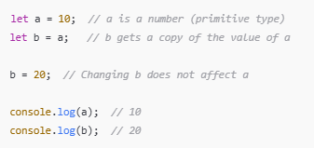
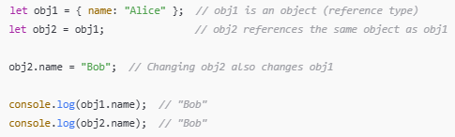
Primitive And Reference Data Types:
Primitive: Primitive data types are passed by value, meaning if you assign one variable to another, changing the new variable does not affect the original one.
Reference :
Reference data types are passed by reference. This means that if you assign one reference type to another, both variables will point to the same location in memory. So, if you change one of them, the other will also change.

Slide 6


Numbers in JavaScript are like the digits you use for counting or measuring things. They can be whole numbers, or floating-point numbers (num with a decimal point) such as 5, 10.25 and -3.14.
Strings in JavaScript, strings are what we use to represent text. Your name or your email address can both be represented as strings in JavaScript. e.g., “My first string”;
Booleans are values that can either be true or false.
AND (&&) Operator:
If both outputs are true = True
If first output is true and the other is false = False
If first output is false and the other is true = False
If both outputs are false = False
OR (||) Operator:
If both outputs are true = True
If first output is true and the other is false = True
If first output is false and the other is true = True
If both outputs are false = False
!(NOT): //Use it to turn false into true or true into false.

Slide 7
Think of variables as labeled boxes where you can store different values. You can name each box (variable name) and put a value inside it. Later, you can access or modify the contents by referring to the box's name. To update the value, simply assign a new value using “=”.
Example: B44 - 45 & L17 - 18
var nick;
This line creates a variable named nick with an undefined value because no value was assigned.
var age = 12;
This line assigns the value 12 to the variable age, and the value will be displayed when you reference the variable.
Variables

Slide 8









A) Joining strings together: B-52 & L-25
B) Finding the length of a string use:
C) Getting a single character: B-53 & L-26
D) Numbers and operators: B-42 & L-15
E) Post Incrementing: B-48 & L-21
EXAMPLES:
EXAMPLES: F) Pre Decrementing: G) Boolean AND Operator: B-58 & L-31
OR Operator:
H) Numbers with Boolean: B-60 & L-33

Slide 9


Examples:
Changing string to lower or upper case: B-55 & L-28
"Hello there, how are you doing?".toUpperCase(); //"HELLO THERE, HOW ARE YOU DOING?"
"hELlo THERE, hOW ARE yOu doINg?".toLowerCase(); //"hello there, how are you doing?"
Assigning, Equal to And Double equals:
A single = sign is to assign a value to a variable
A Double == sign is to converting a value from one data type to another
The triple === sign means equal to
Equal to: B-62 & L-35
Double sign: B-63 & L-36

Slide 10
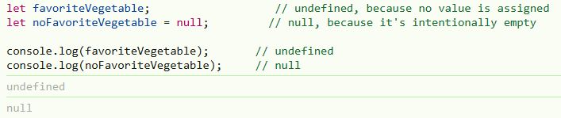
Undefined & Null:
undefined: Happens automatically when a variable is declared but not assigned a value.
null: You set it manually to indicate that a variable has no value (intentionally empty).

Slide 11
A slice() is the method used to extract a section of the array and returns it as a new array, without modifying the original array.
Example 1: B-41 & L-27
"This is a long string".slice(0, 4);
The .slice(0, 4) method extracts characters from index 0 to 3, excluding index 4.
Which will display “This”.
Example 2:
"Hello, World!".slice(7, 12);
This will display “World”
Using Slice method

Slide 12

Do all the try outs and upload to github.
Page (B-44 & L-17)
Page (B-50 & L-23)
Page (B-64 & L-37)
Practice Exercises

Slide 13
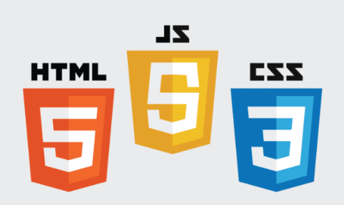
End Of Chapter 2

